Slide 1
CA 7503 Software Testing

Slide 2
Lecture 2 : The Realities of Software Testing

Slide 3
What is Software Testing?
Software testing is a process of executing a program or application with the intent of finding the software bugs.
It can also be stated as the process of validating and verifying that a software program or application or product: Meets the business and technical requirements that guided it's design and development.

Slide 4
What is Software Testing?
Testing software typically involves:
Executing software with inputs representative of actual operation conditions (or operational profiles )
Comparing produced/expected outputs
Comparing resulting/expected states
Measuring execution characteristics (e.g., memory used, time consumed, etc.)

Slide 5
Terminology
Fault: an imperfection that may lead to a failure
E.g., missing/incorrect code that may result in a failure
Bug: another name for a fault in code
Error: where the system state is incorrect but may not have been observed
Failure: some failure to deliver the expected service that is observable to the user

Slide 6
A few more definitions
Test Case: set of inputs, execution conditions, and expected results developed for a particular objective
Test Suite: collection of test cases, typically related by a testing goal or an implementation dependency
Test Driver: class or utility program that applies test cases
Test harness: system of test drivers and other tools that support test execution.
Test Strategy: algorithm or heuristic to create test cases from a representation, implementation, or a test model.
Oracle: means to check the output from a program is correct for the given input.
Stub: partial temporary implementation of a component (usually required for a component to operate)

Slide 7
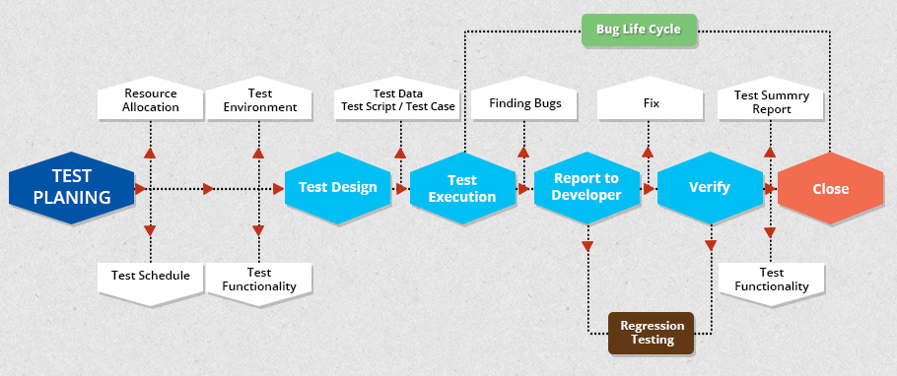
A Software Testing Process

Slide 8
Software process models are an ideal … not reality
No software development effort follows a process model perfectly. Why?
The specification never corresponds to the customers needs perfectly.
There is never enough time to perform all of the testing.
Nevertheless, an ideal model is helpful to make progress.
Trade offs and concessions are inevitable.

Slide 9
Software testing axioms
It is impossible to test a program completely.
Software testing is a risk-based exercise.
Testing cannot show the absence of bugs.
The more bugs you find, the more bugs there are.
Not all bugs found will be fixed.
It is difficult to say when a bug is indeed a bug.
Specifications are never final.
Software testers are not the most popular members of project.
Software testing is a disciplined and technical profession.

Slide 10
What is an axiom anyway?
An axiom is a sentence or proposition that is not proved or demonstrated and is considered as obvious or as an initial necessary consensus for a theory building or acceptation.
Therefore, it is taken for granted as true, and serves as a starting point for deducing and inferring other (theory dependent) truths.

Slide 11
Peano’s axioms for the structure of natural numbers
1 is a natural number.
Every natural number is equal to itself (equality is reflexive).
For all natural numbers a and b, a = b if and only if b = a (equality is symmetric).
For all natural numbers a, b, and c, if a = b and b = c then a = c (equality is transitive).
If a = b and b is a natural number then a is a natural number.
If a is a natural number then successor(a) is a natural number.
If a and b are natural numbers then a = b if and only if successor(a) = successor(b).
If a is a natural number then successor(a) is not equal to 1.
For every set K, if 1 is in K, and successor(x) is in K for every natural number x in K, then every natural number is in K.

Slide 12
Discussion …
Are software testing axioms really axioms?
If not, what would you call them?

Slide 13
Axiom 1
It is impossible to test a program completely
How many test cases do you need to exhaustively test:
Powerpoint
A calculator
MS Word
Any interesting software!
The only way to be absolutely sure software works is to run it against all possible inputs and observe all of its outputs …
Oh, and the specification must be correct and complete.

Slide 14
Axiom 1
It is impossible to test a program completely
There are the reasons below:
The number of possible inputs is very large.
The number of possible outputs is very large.
The number of paths through the software is very large.
The software specification is subjective.

Slide 15
Axiom 2
Software testing is a risk-based exercise
If you do not test the software for all inputs (a wise choice) you take a risk.
Hopefully you will skip a lot of inputs that work correctly.
What if you skip inputs that cause a fault?
Risk: financial loss, security, loss of money, loss of life!
That is a lot of pressure for a tester!

Slide 16
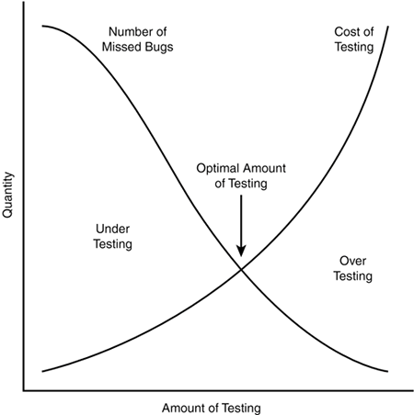
Axiom 2
If you try to test too much, the development cost becomes prohibitive.
If you test too little, the probability of software failure increases and as we discussed … software failures can cost us big time!

Slide 17
Axiom 3
Testing cannot show the absence of bugs
“Program testing can be used to show the presence of bugs, but never to show their absence!”
- Edsger Wybe Dijkstra
Are there bugs in our software?
Are there bugs in other software?
Can you guarantee that there are no bugs to find?

Slide 18

Axiom 4
The More Bugs You Find, the More Bugs There Are
Bugs appear in groups, where you see one you will likely find more … Why?
Programmers can have bad days
Programmers tend to make the same mistakes
Some bugs are just the tip of the iceberg.

Slide 19
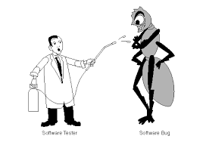
Axiom 4
Boris Beizer coined the term pesticide paradox to describe the phenomenon that the more you test software the more immune it becomes to your test cases.
Remedy: continually write new and different tests to exercise different parts of the software.

Slide 20
Axiom 5
Not all bugs found will be fixed.
There are several reasons why you might choose not to fix a bug:
There’s not enough time
Some deadlines cannot be extended (e.g., Y2K)
It’s not really a bug
Specifications can be wrong
It’s too risky to fix
“I’m not touching Murphy’s code!”
It’s just not worth it
Bugs in fringe features may have to wait
Why not charge the customer for bug fixes in the next release (sound familiar?) ☺
The decision-making process usually involves the software testers, the project managers, and the programmers.

Slide 21
Axiom 6
It is difficult to say when a bug is indeed a bug.
if there is a problem in the software but no one ever discovers it … is it a bug?
Parody of “if a tree falls in the forest … does it really make a noise?”
What is your opinion? Does a bug have to be observable in order for it to me a bug?
Bugs that are undiscovered are called latent bugs.

Slide 22
Axiom 7
Specifications are never final
Building a product based on a “moving target” specification is fairly unique to software development.

Slide 23
Axiom 8
Software testers are not the most popular members of a project
Goal of a software tester:
Find bugs
Find bugs early
Make sure bugs get fixed
Tips to avoid becoming unpopular:
Find bugs early
Temper your enthusiasm … act in a professional manner
Don’t report just the bad news

Slide 24
Axiom 9
Software Testing Is a Disciplined Technical Profession
When software was simpler and more manageable, software testers were often untrained and testing was not done methodically
It is now too costly to build buggy software. As a result testing has matured as a discipline.
Sophisticated techniques
Tool support
Rewarding careers

Slide 25
Some Terminology
Verification
“Are we building the product right?”
Does the software meet the specification?
Validation
“Are we building the right product?”
Does the software meet the user requirements?
Software Quality Assurance
Not the same as software testing …
Create and enforce standards and methods to improve the development process and to prevent bugs from occurring.

